Slide 1
ILD PAK PCS Registry and NSIP Guideline
Dr. Mosavir Ansarie

Slide 2
The PCS ILD Guideline Committee has been in a phase of continuous activity during the last few years in order to collect and provide local and international data and information to our fellow physicians in Pakistan.

Slide 3
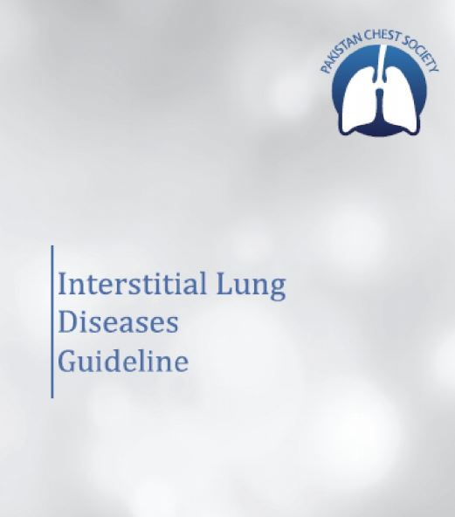
April 2016
ILD with Focus on HRCT and IPF

Slide 4
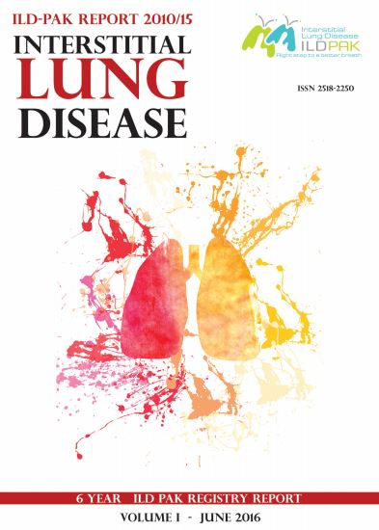
Pilot study of 325 patients from a Metropolitan city of Pakistan

Slide 5
September 2016

Slide 6
With accomplishment of these projects the committee decided to invigorate the process of data collection in the registry across the country.
To maintain the standards of unbiased research CRO was appointed for co-ordination and facilitation of the process between various investigating centers.
Ethical approval was obtained and contractual agreements were approved between PCS, CRO and the consenting Principal Investigators.

Slide 7
Participating Centers

Slide 8
PCS ILD PAK Registry provides an electronic data base of more than a 100 variables for direct input from each of the investigators who have an individual access code ensuring confidentiality of data.
The principal investigator has an IPR to publish his data independently with the consent and acknowledgement of PCS ILD-PAK or collectively at the end of tenure of this registry after 15 months of data recording.

Slide 9
Interim PCS-ILD PAK Report
Until end February 2018, the number of cases entered in the PCS ILD PAK Registry are 435 with a Provincial breakdown of Sindh 283, Punjab 100, KPK 52 cases respectively.
The frequency of major ILD sub-types shows: ▪IPF 35%, ▪iNSIP & CTD-NSIP 19% ▪HP 16%

Slide 10
NSIP Guideline Committee meeting
November 2016, Islamabad

Slide 11
Steps of Guideline Evolution
Template presentation by key contributors.
Deliberation and approval by the committee members.
Search of relevant literature published upto 2017 inclusive.
Collection, incorporation, edition, referencing and non-committee peer review before publication

Slide 12
March 2018

Slide 13
The present document is meant to be a Guideline on Non-Specific Interstitial Pneumonia (NSIP)
Part A: Introduction to ILD Classification
Part B: Idiopathic Non-specific Pneumonia (iNSIP)
Part C: Connective Tissue Disease related NSIP (CTD-NSIP).
It comprises of 42 pages text with 14 pictures and 8 tables

Slide 15
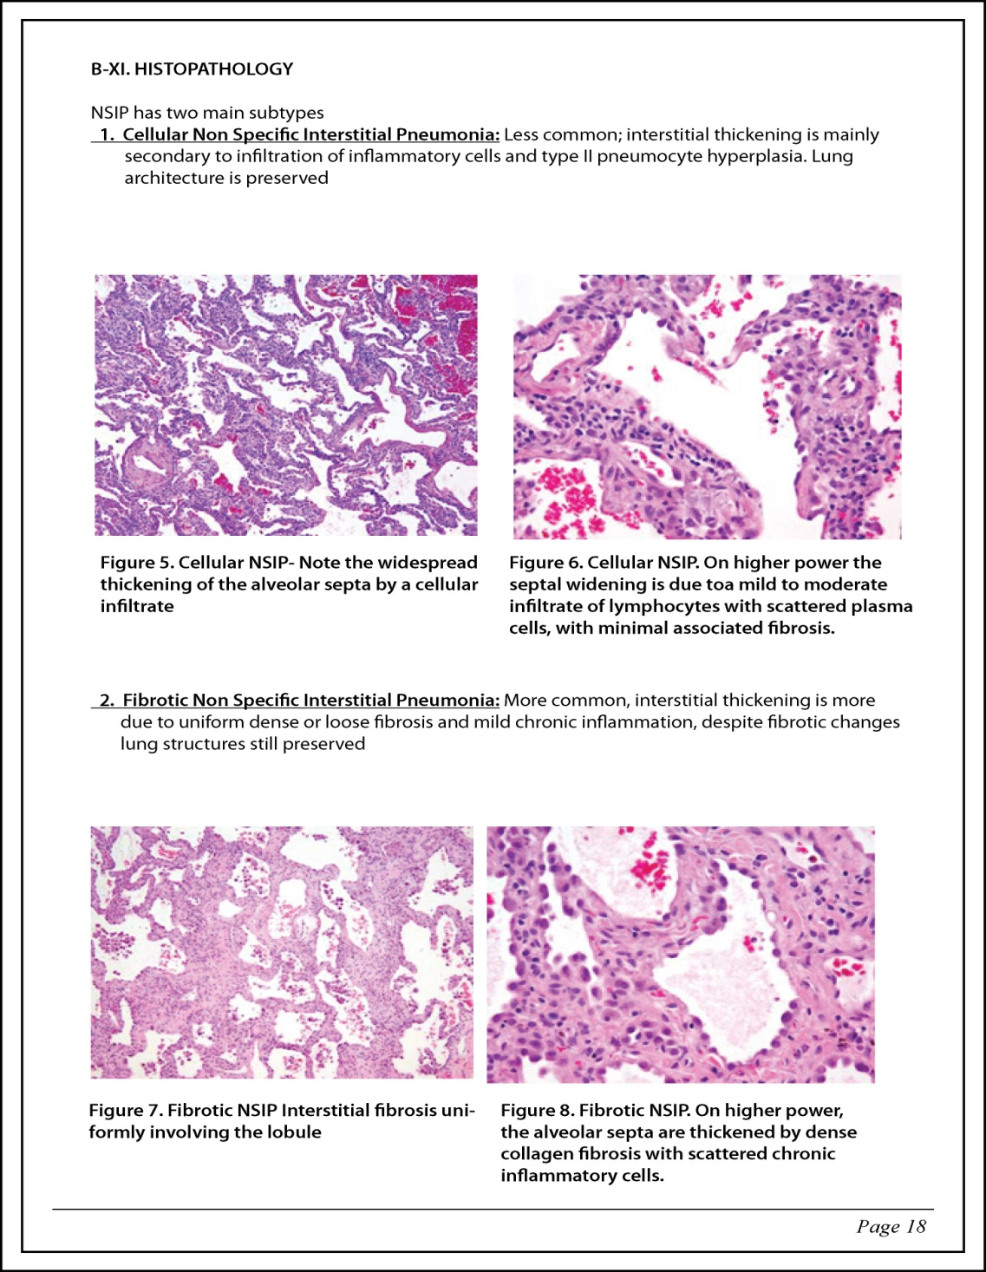

Slide 18
